Slide 1
Introduction To Web
Notes:
‹#›

Slide 2
Web ≠ Internet
Internet : a physical network connecting millions of computers using the same protocols for sharing/transmitting information (TCP/IP)
  in reality, the Internet is a network of smaller networks
World Wide Web: a collection of interlinked multimedia documents that are stored on the Internet and accessed using a common protocol (HTTP)
Key distinction: Internet is hardware; Web is software along with data, documents, and other media
Many other Internet-based applications exist
e.g., email, telnet, ftp, usenet, instant messenging services, file-sharing services, …

Slide 3
A (Very Brief) History of the Internet
The idea of a long-distance computer network traces back to early 60's
In particular, the US Department of Defense was interested in the development of distributed, decentralized networks
In 1969, Advanced Research Project Agency funded the ARPANET
  connected computers at UC Los Angeles, UC Santa Barbara, Stanford Research Institute, and University of Utah
  allowed researchers to share data, communicate
    56Kb/sec communication lines (vs. 110 b/sec over phone lines)

Slide 4
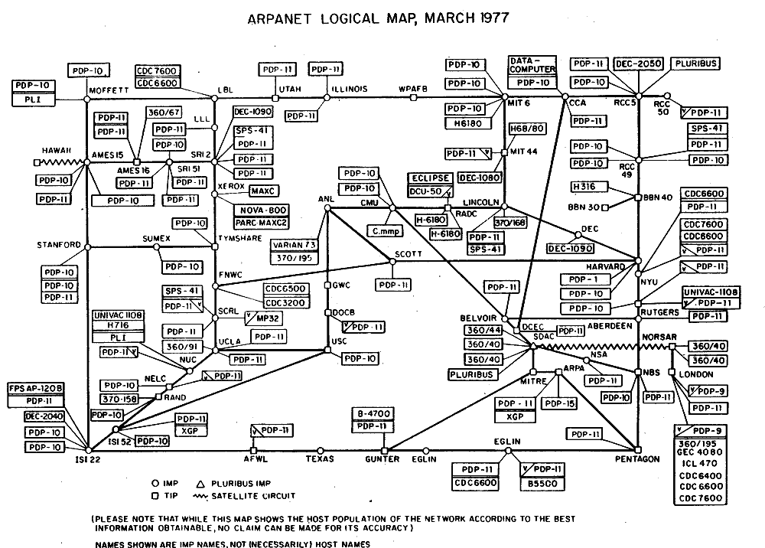
ARPANET (1977, from the Computer History Museum)

Slide 5
Internet Growth
throughout the 70's, the size of the ARPANET doubled every year
  first ARPANET e-mail sent in 1971
  decentralization made adding new computers easy
  TCP/IP developed in the mid 1970s for more efficient packet routing
  migration of ARPANET to TCP/IP completed 1 January, 1983
  ~1000 military & academic host computers connected by 1984
In 80‘s, U.S. government took a larger role in Internet development
  created NSFNET for academic research in 1986
  ARPANET was retained for military & government computers
by 90's, Internet connected virtually all colleges & universities
  businesses and individuals also connecting as computing costs fell
  ~1,000,000 computers by 1992
in 1992, control of the Internet was transferred to a non-profit org
  Internet Society: Internet Engineering Task Force
  Internet Architecture Board
  Internet Assigned Number Authority
  World-Wide-Web Consortium (W3C)

Slide 6
Internet Growth (cont.)
Year | Computers on the Internet (at any one time?)
2011 | ~605,000,000
2006 | 439,286,364
2004 | 285,139,107
2002 | 162,128,493
2000 | 93,047,785
1998 | 36,739,000
1996 | 12,881,000
1994 | 3,212,000
1992 | 992,000
1990 | 313,000
1988 | 56,000
1986 | 5,089
1984 | 1,024
1982 | 235
Internet has exhibited exponential growth,
doubling in size every 1-2 years
(stats from Internet Software Consortium)
2,405,518,376 Internet users (approx. 34.3% of the world’s population)
(http://www.internetworldstats.com/top20.htm)
(June 30, 2012)
United Kingdom has 52.7 million users (approx. 83.6% of the population)
Partial map of the internet (circa Jan 2005, by
the Opte Project (opte.org)

Slide 7
(A Very Brief) History of the Web
in 1989, Tim Berners-Lee at the European Particle Physics Laboratory (CERN) designed a hypertext system for linking documents over the Internet
  designed a (Non-WYSIWYG) language for specifying document content
    evolved into HyperText Markup Language (HTML)
  designed a protocol for downloading documents and interpreting the content
    evolved into HyperText Transfer Protocol (HTTP)
  implemented the first browser -- text-based, no embedded media
    the Web was born!

Slide 8
History of the Web (cont.)
the Web was an obscure, European research tool until 1993
in 1993, Marc Andreessen and Eric Bina (at the National Center for Supercomputing Applications, a unit of the University of Illinois) developed Mosaic, one of the early graphical Web browsers that popularized the WWW for the general public (Erwise was the first one, Viola WWW the second)
  the intuitive, clickable interface helped make hypertext accessible to the masses
  made the integration of multimedia (images, video, sound, …) much easier
  Andreessen left NCSA to found Netscape in 1994
    cheap/free browser further popularized the Web (75% market share in 1996)
in 1995, Microsoft came out with Internet Explorer
Opera web browser released in 1996
    Netscape bought by AOL in 1998 for US$4.2 billion in stock
    Firefox web browser, version 1.0, released in 2004
    Google Chrome released in 2008
today, the Web is the most visible aspect of the Internet

Slide 9
Web Growth
Stats from
Netcraft Web Server Survey.
Year | Computers on the Internet | Web Servers on the Internet
2011 | ~605,000,000 | ~250,000,000
2008 | ?????? | 172,338,726
2006 | 439,286,364 | 85,541,228
2004 | 285,139,107 | 56,923,737
2002 | 162,128,493 | 33,082,657
2000 | 93,047,785 | 18,169,498
1998 | 36,739,000 | 4,279,000
1996 | 12,881,000 | 300,000
1994 | 3,212,000 | 3,000
1992 | 992,000 | 50
Google Chrome
Firefox
Safari
IE, Opera
Netscape
Mosaic
A 2012 estimate suggests 30-35 billion Web pages! (Google’s estimated index size is about 30 billion webpages.) (WorldWideWebSize.com)

Slide 10
Web growth (cont.)
Internet addresses are used to identify computers on the internet.
Internet Protocol version 4 (IPv4) was first defined in 1981 and is still in use today, but this uses a 32-bit number to specify addresses.
IPv4 provides around 4.29 billion (i.e. 4.29 x 10⁹) addresses.
The Internet Assigned Numbers Authority(IANA) exhausted their allocated addresses on February 3, 2011
IPv6 began deployment in 1999 and uses 128 bit addresses, but is also redesigned to allow more efficient routing, network aggregation, and ease of network reconfiguration. (And has about 3.4 x 10³⁸ address.)

Slide 11
Static vs. Dynamic pages
most Web pages are static
  contents (text/links/images) are the same each time it is accessed
  e.g., online documents, most homepages
  HyperText Markup Language (HTML) is used to specify text/image format
as the Web continues to move towards more and more online services and e-commerce continues to grow, Web pages must also provide dynamic content
  pages can be fluid, changeable (e.g., rotating banners)
  must be able to react to the user's actions, request and process info, tailor services
  e.g., amazon.com
t

Slide 12
Client-Side Programming
can download program with Web page, execute on client machine
  simple, generic, but sometimes insecure (e.g. cross-site scripting attacks)
JavaScript
  a scripting language for Web pages, developed by Netscape in 1995
  uses a C++/Java-like syntax, so familiar to programmers, but simpler
  good for adding dynamic features to Web page, controlling forms and GUI
  requires users to have this technology enabled on their browsers
  see http://www.w3schools.com/js/
  JQuery, first released in 2006, is a library to help with cross-browser compatibility issues and is used by more than 60% of the 10,000 most visited websites (source: SimilarTech)
Java applets
  can define small, special-purpose programs in Java called applets
  provides (almost) full expressive power of Java (but with more overhead)
  good for more complex tasks or data heavy tasks, such as graphics
  see http://java.sun.com/applets/

Slide 13
Server-Side Programming
can store and execute program on Web server, link from Web page
  more complex, requires server privileges, but can still be (mostly) secure
Common Gateway Interface (CGI) programming
  programs can be written to conform to the CGI
  when a Web page submits, data from the page is sent as input to the CGI program
  CGI program executes on server, sends its results back to browser as a Web page
  good if computation is large/complex or requires access to private data
  we will discuss CGI programming using Perl, but other languages are possible as well (such as Python, Ruby, etc.)
Active Server Pages (ASP), Java Servlets, PHP, Server Side Includes, Ajax
  some of these are vendor-specific alternatives to CGI (such as Microsoft’s ASP)
  provide many of the same capabilities as CGI programs but using HTML-like tags
  some of these technologies might require functionality to be enabled in the client’s browser (e.g. Ajax generally requires the use of Javascript combined with PHP or some other server-based programming component)

Slide 14
Exercise
pick some of your favorite Web sites and try to identify
  static components?
  dynamic components?
    client-side? JavaScript? Java applet?
    server-side? CGI? ASP?
e.g., www.liv.ac.uk
www.amazon.co.uk
gmail (uses Ajax for lots of its dynamic functions)

Slide 15
World Wide Web
A network of server and client computers that share information
Various components
  Architecture of the Web
  Explore Web addresses
  Hypertext Markup Language (HTML)

Slide 16
Web Architecture
Web Client computers run Web browsers
  Applications that request Web pages
Web server
  A computer running special Web server software that services client requests for Web pages
Network
  A communication path between a sender and a receiver

Slide 17
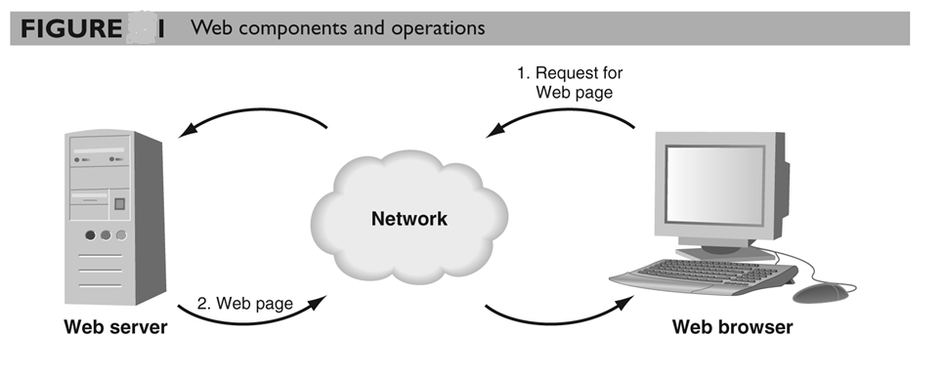
Web Architecture

Slide 18
Web Architecture (cont’d)
Web page is a file with an .html or .htm extension
  Contains hypertext markup language (HTML) commands
In the Web-database architecture, the database server process runs on a separate server from the Web server process

Slide 19
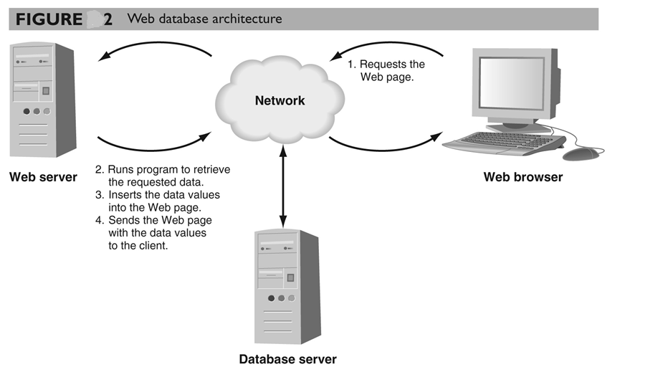
Web Architecture (cont’d)

Slide 20
Tiered Architectures
System
  A group of interrelated elements forming a collective entity
Architecture
  A style and method of design and construction
‹#›

Slide 21
An architectural history of computing
1 tier architecture
  monolithic Information Systems
  presentation, application logic, and resource management were merged into a single tier
2 tier architecture
  separation of presentation tier from other 2 tiers (app + resource)
  became popular as 'client/server' systems
3 tier architecture
  can be achieved by separating RM (resource management) from application logic tier
‹#›
Notes:
‹#›

Slide 22


Tiers of an architecture
browser
Client
Presentation
tier
<html>
...
</html>
Visualise
Application
logic tier
information system
Calculate
Resource
management tier
Store
‹#›
Notes:
‹#›

Slide 23
Presentation Tier
Any IS needs to communicate with external entities, human users or other computers
Allows these entities to interact with the system
Implemented as a GUI interface
Referred to as the client of the IS – which is not correct
Example:
  Systems accessed by web browsers using plain HTML documents
  The client is a web browser that only displays information prepared by the Web server
  The presentation layer in this case is the Web server
How the data should appear to the user and how the user should interact with the interface
‹#›
Notes:
‹#›

Slide 24
Application Logic Tier
IS do more than information delivery, they perform data processing (Business Logic & calculation) behind the results being delivered
Example:
  A program that implements a withdrawal operation from a bank
  This program takes the request, checks whether there is enough funds, verifies whether withdrawal limits are exceeded, creates a log entry for the operation, performs the operations against the current balance and gives approval for handing out the money.
  Here the algorithms are implemented
This tier is often referred to as
  Services
  Business logic
  Business rules
  Server
‹#›
Notes:
‹#›

Slide 25
Resource Management Layer
IS needs data to work with
Data can reside in databases or other information repositories
Deals with and implements different data sources of Information Systems
Also referred to as the data layer, which indicates that it is implemented using a Database Management System
From the banking example:
  The RM layer could be the account database of the bank
Can also be a gateway to recursively using other ISs
‹#›
Notes:
‹#›

Slide 26
1 – Tier Architectures
Mainframe-based and the system took place through dumb terminals
Monolithic Information Systems
Presentation, application logic, and resource management were merged into a single tier
Many of these 'old' Systems are still in use!
Due to its monolithic nature it did not provide an entry point from the outside except the channel to the dumb terminals
Considered as ‘black box’
‹#›
Notes:
‹#›

Slide 27
Design of 1 – Tier Architecture
Advantages:
easy to optimise performance
no context switching
no compatibility issues
no client developement, maintainance and deployment cost
Disadvantages:
monolithic pieces of code (high maintainance)
hard to modify – lack of documentation and qualified programmers
lack of qualified programmers for these systems
Client
Presentation
layer
Application
logic layer
information system
Resource
management layer
‹#›
Notes:
‹#›

Slide 28
2 - Tier Architectures
Client
fig 1.7 p.12
Information system
Resource management layer
‹#›
Notes:
‹#›

Slide 29
2 - Tier Architectures
Coming of PC was the real push to 2-tier architectures
Separation of presentation layer from other 2 layers (app + resource)
  Client/server systems with thin clients/fat clients
  Use RPC (Remote Procedure Call) to communicate between tiers
  Need for standardisation for inter-tier communication
Advantages
  portability
  no need for context switches or calls between component for key operations
Disadvantages
  limited scalability
  legacy problems (blown up clients)
‹#›
Notes:
‹#›

Slide 30
3 - Tier Architectures
client
presentation
layer
application logic layer
middleware
information system
resource management layer
‹#›
Notes:
‹#›

Slide 31
3 - Tier Architectures
The former created islands of information where a set of clients could communicate with a server but not with other servers
3-tier made it technically possible to integrate different servers
Separating RM (resource management) from application logic layer
  Additional middleware layer between client and server
    integration logic
    application logic
Lead to the introduction of clear RM layer interfaces
Good at dealing with integration of different resources
‹#›
Notes:
‹#›

Slide 32
3 - Tier Architectures
Advantages
  scalability by running each layer on a different server
  scalability by distributing AL (application logic layer) across many nodes
  additional tier for integration logic
  Flexibility
Disadvantages
  performance loss if distributed over the internet
  problem when integrating different 3 – tier systems
‹#›
Notes:
‹#›

Slide 33
3 - tier Architectures
client
GUI clients
C++, VB, Java
presentation
layer
application logic layer
Middleware
Server
middleware
information system
Databases
resource management layer
Legacy Systems
‹#›
Notes:
‹#›

Slide 34
Middleware
Middleware refers to the software which is common to multiple applications and builds on the network transport services to enable ready development of new applications and network services.
Middleware typically includes a set of components such as resources and services that can be utilised by applications either individually or in various subsets.
  Examples of services: Security, Directory and naming, end-to-end quality of service, support for mobile code.
Examples:
  OMG’s CORBA
  J2EE - Java 2 Enterprise Edition
  Microsoft’s .Net
‹#›

Slide 35
Middleware features
Allows communication
  through a standard language
  across different platforms
  between legacy and modern applications
Takes care of
  transactions between servers
  data conversion
  authentication
  communications between computers
‹#›

Slide 36
Middleware features
Provides runtime environment for components in the middle-tier
  Component lifecyle and management
  Transaction, event and security services
  Provides connections to databases, mainframes and legacy systems
Separates client-tier from the data source
  Clean separation of user-interfaces and presentation logic from the data source
‹#›

Slide 37
n -tier
client
Web browser
Web server
fig 1.12 p. 20
presentation
layer
HTML filter
information system
resource management layer
‹#›
Notes:
‹#›

Slide 38
General benefits of adding tiers
With growing number of tiers one gains:
flexibility
functionality
possibilities for distribution
But:
Each tier increases communication costs
Complexity rises leading to higher cost and risk
  Higher complexity of development
  Higher complexity of management and tuning
Redundency increases
‹#›
Notes:
‹#›

Slide 39
Needs of large business Applications
Functionality
Stability
Adaptability under rising workloads and changing business requirements
Highest levels of performance and availability
Cost Effective

Slide 40
Contents of Business Applications
Business Logic
Database
Graphical User Interface

Slide 41
Explanation of keywords
Business Logic: Rules governing the business. These can change frequently depending upon the business.
Database: Contains the data relevant for the business.
Graphical User Interface: Provides the platform for interaction of the user with the system.

Slide 42
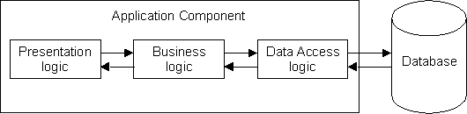
The 1-Tier Architecture

Slide 43
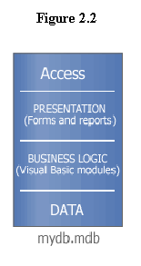
The 1-Tier Architecture

Slide 44
The 1-Tier Architecture
Advantages
  Easy and quick to develop
  Useful for small offices
Disadvantages
  Difficult to upgrade
  Not scalable
  Don't protect valuable "Business Logic"

Slide 45
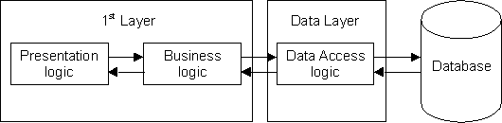
The 2-Tier Architecture

Slide 46
The 2-Tier Architecture
Advantages:
Protects business logic from UI
Disadvantages:
Business-logic is implemented on the PC
Increased network traffic
Application logic can’t be reused
Must design/implement protocol for communication between client and server.

Slide 47
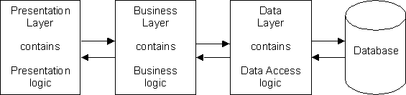
The 3-Tier Architecture

Slide 48
The 3-Tier Architecture
Advantages
Clear separation of user-interface-control and data presentation from application-logic.
Change in business logic wont need change in other layers.
Dynamic load balancing by use of multiple servers

Slide 49
N-tier architecture
Also known as the “layered” architecture
N usually denotes 3 or more tiers (layers)
Can be used to model both a web-based application and a desktop application

Slide 50
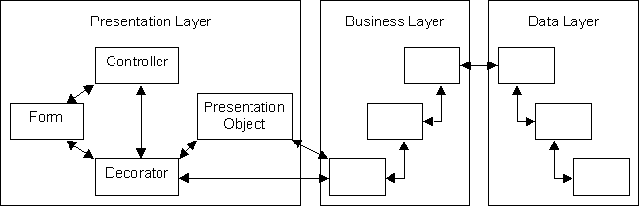
The N-tier architecture

Slide 51
The N-tier architecture
The tiers may contain one or more components of the application
The components in one tier can communicate ONLY with the components in the tiers above and below

Slide 52
The N-tier architecture
The components implement major functionalities in the application
Every application can have at least three tiers:
  The UI tier
  The Business Logic tier
  The Data Storage tier

Slide 53
The N-tier architecture
Disadvantages
In small applications, the benefits are usually not visible.
Every data that goes in the system from the user to the database must pass through the components in the middle layers, and therefore the response time of the system will be slower.

Slide 54
The N-tier architecture
Advantages
Easy to change: you can decide to switch from desktop applications to web based applications by just changing the UI layer (a small part of the application). The same thing with the database system.
Easy to manage: if each layer has its own functionality, when something needs to be changed you will know what to change

Slide 55
The N-tier architecture
Advantages
Easy to reuse: if another application is developed for the same domain, it can use a big part of the business layer
Easy to develop: each layer can be developed by separate teams, and focus only on theirs specific problems (you don’t have to know HTML, ASP, OO design and SQL at the same time)

Slide 56
Web Addressing Concepts
Communication protocols
Uniform Resource Locators (URLs)
Ports
DNS

Slide 57
Communication Protocols
Communication protocol is an agreement between a sender and a receiver
  Specifies how the data is format, sent, and received
Internet Protocol (IP)
  Primary communication protocol used by most Internet traffic

Slide 58
Communication Protocols (cont’d)
A domain name server converts the domain name to its associated numeric IP address
HyperText Transfer Protocol
  A communication protocol that works with and on top of IP
  Coordinates the messages between a browser and Web server
  Determines how the Web server sends html files to browsers

Slide 59
Uniform Resource Locators
First component in a URL is the communication protocol, usually http://
Folder path specifies the Web page’s location in the Web server’s file system
URL does not include a folder path and filename - the Web server returns its default document, which is a home page/index page

Slide 60
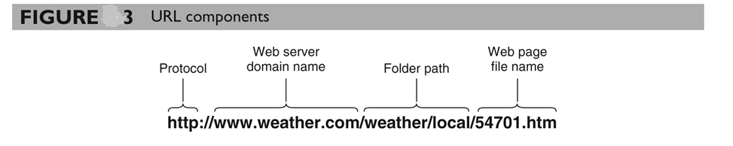
Uniform Resource Locators
If file name is missing
  index.htm, default.htm, main.htm, home.htm

Slide 61
Ports
The address for a server process is called a port
  A value that references a server process using a number between 0 and 65,535
A server maintains an IP port table
  Contains port numbers in one column
  Main memory locations of associated server processes in the second column
  http://localhost:1685/WebExamples/Default.aspx

Slide 62
The DNS is…
The “Domain Name System”
What Internet users use to reference anything by name on the Internet
The mechanism by which Internet software translates names to attributes such as addresses

Slide 63
The DNS is also…
A globally distributed, scalable, reliable database
Comprised of three components
  A “name space”
  Servers making that name space available
  Resolvers (clients) which query the servers about the name space

Slide 64
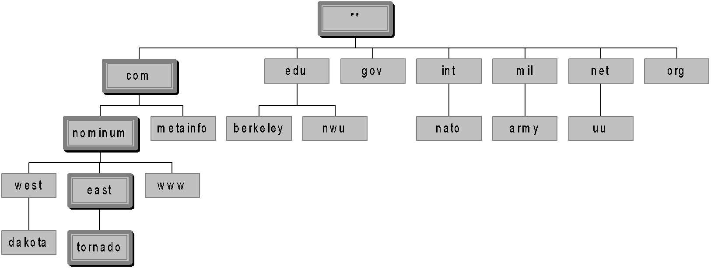
Domain Names
A domain name is the sequence of labels from a node to the root, separated by dots (“.”s), read left to right
  The name space has a maximum depth of 127 levels
  Domain names are limited to 255 characters in length
A node’s domain name identifies its position in the name space

Slide 65
Subdomains
One domain is a subdomain of another if its domain name ends in the other’s domain name
  So sales.nominum.com is a subdomain of
    nominum.com & com
  nominum.com is a subdomain of com

Slide 66
The Resolution Process
Let’s look at the resolution process step-by-step:
annie.west.sprockets.com
ping www.nominum.com.

Slide 67
The Resolution Process
The workstation annie asks its configured name server, dakota, for www.nominum.com’s address
dakota.west.sprockets.com
What’s the IP address of www.nominum.com?
annie.west.sprockets.com
ping www.nominum.com.

Slide 68
The Resolution Process
The name server dakota asks a root name server, m, for www.nominum.com’s address
m.root-servers.net
dakota.west.sprockets.com
What’s the IP address of www.nominum.com?
annie.west.sprockets.com
ping www.nominum.com.

Slide 69
The Resolution Process
The root server m refers dakota to the com name servers
This type of response is called a “referral”
m.root-servers.net
dakota.west.sprockets.com
Here’s a list of the com name servers. Ask one of them.
annie.west.sprockets.com
ping www.nominum.com.

Slide 70
The Resolution Process
The name server dakota asks a com name server, f, for www.nominum.com’s address
What’s the IP address of www.nominum.com?
m.root-servers.net
dakota.west.sprockets.com
f.gtld-servers.net
annie.west.sprockets.com
ping www.nominum.com.

Slide 71
The Resolution Process
The com name server f refers dakota to the nominum.com name servers
Here’s a list of the nominum.com name servers. Ask one of them.
m.root-servers.net
dakota.west.sprockets.com
f.gtld-servers.net
annie.west.sprockets.com
ping www.nominum.com.

Slide 72
The Resolution Process
The name server dakota asks a nominum.com name server, ns1.sanjose, for www.nominum.com’s address
What’s the IP address of www.nominum.com?
m.root-servers.net
dakota.west.sprockets.com
ns1.sanjose.nominum.net
f.gtld-servers.net
annie.west.sprockets.com
ping www.nominum.com.

Slide 73
The Resolution Process
The nominum.com name server ns1.sanjose responds with www.nominum.com’s address
m.root-servers.net
dakota.west.sprockets.com
Here’s the IP address for www.nominum.com
ns1.sanjose.nominum.net
f.gtld-servers.net
annie.west.sprockets.com
ping www.nominum.com.

Slide 74
The Resolution Process
The name server dakota responds to annie with www.nominum.com’s address
Here’s the IP address for www.nominum.com
m.root-servers.net
dakota.west.sprockets.com
ns1.sanjose.nominum.net
f.gtld-servers.net
annie.west.sprockets.com
ping www.nominum.com.

Slide 75
Resolution Process (Caching)
After the previous query, the name server dakota now knows:
  The names and IP addresses of the com name servers
  The names and IP addresses of the nominum.com name servers
  The IP address of www.nominum.com
Let’s look at the resolution process again
annie.west.sprockets.com
ping ftp.nominum.com.

Slide 76
Resolution Process (Caching)
The workstation annie asks its configured name server, dakota, for ftp.nominum.com’s address
m.root-servers.net
dakota.west.sprockets.com
What’s the IP address of ftp.nominum.com?
ns1.sanjose.nominum.net
f.gtld-servers.net
annie.west.sprockets.com
ping ftp.nominum.com.

Slide 77
Resolution Process (Caching)
dakota has cached a NS record indicating ns1.sanjose is an nominum.com name server, so it asks it for ftp.nominum.com’s address
What’s the IP address of ftp.nominum.com?
m.root-servers.net
dakota.west.sprockets.com
ns1.sanjose.nominum.net
f.gtld-servers.net
annie.west.sprockets.com
ping ftp.nominum.com.

Slide 78
Resolution Process (Caching)
The nominum.com name server ns1.sanjose responds with ftp.nominum.com’s address
m.root-servers.net
dakota.west.sprockets.com
Here’s the IP address for ftp.nominum.com
ns1.sanjose.nominum.net
f.gtld-servers.net
annie.west.sprockets.com
ping ftp.nominum.com.

Slide 79
Resolution Process (Caching)
The name server dakota responds to annie with ftp.nominum.com’s address
Here’s the IP address for ftp.nominum.com
m.root-servers.net
dakota.west.sprockets.com
ns1.sanjose.nominum.net
f.gtld-servers.net
annie.west.sprockets.com
ping ftp.nominum.com.

Slide 80
Hypertext Markup Language (HTML)
HTML provides a standard notation for specifying the appearance and content of Web pages
An HTML document is a text file that contains
  Text and embedded tags
  Codes that specify Web page formatting and links

Slide 81
Tags
A tag is a formatting code
  Encloses a Web page element such as a line of text or an image
  Instructs the browser how to process or display the item
HTML tags appear in angle brackets (<>)
Some tags are one-sided tags
  Do not enclose an element but instead instruct the browser to perform a one-time action

Slide 82
Tags
HTML syntax:
two-sided tag:
<tag attributes>document content</tag>
Closing tag
Starting tag
Properties of the tag.
Optional!
Actual content appears in webpage. It could be empty
Examples: <p> CGS 2100 </p>
<body bgcolor = “yellow”> UCF </body>

Slide 83
HTML Document Structure
An HTML document
  Begins with an opening <html> tag and ends with a closing </html> tag
Heading section is enclosed in <head> tags
Final section of an HTML document is the body section
  Enclosed in <body> tags, and contains all the Web page’s content and format tags

Slide 84
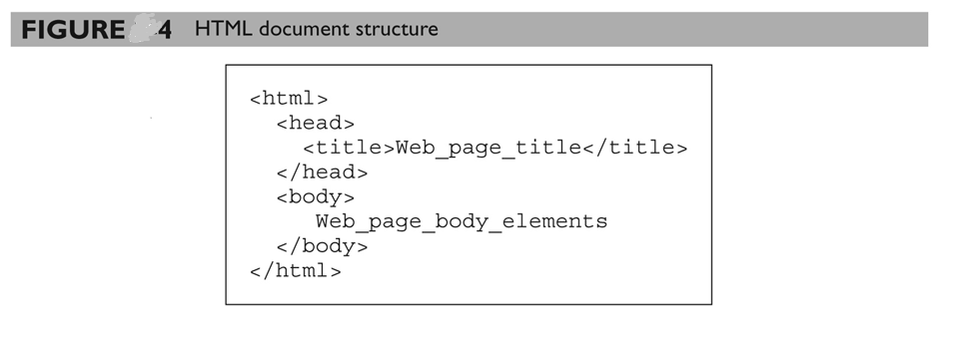
HTML Document Structure

